Slide 1
6. Radial Basis Function Networks
6.1 RBFN structure
6.2 Exact interpolation
6.3 Radial basis functions
6.4 Radial basis function networks
6.5 RBFN training
6.6 RBFN for classification
6.7 Comparison with multilayer perceptron
6.8 Probabilistic networks
6.9 Generalized regression networks
6.10 MATLAB Live Script examples

Slide 2
Introduction
Different class of neural networks
In Multilayer perceptrons
Output is a nonlinear function of the scalar product of input vector and weight vector
Different class is based on Radial Basis Functions (RBF)
Activation of a hidden unit is determined by the distance between input vector and prototype vector
RBF-based networks includes
RBFN = Radial Basis Function Networks
PNN = Probabilistic Neural Networks
GRNN = Generalized regression networks
RBFN theory forms a link between
Function approximation
Regularization
Noisy interpolation
Density estimation
Optimal classification theory

Slide 3
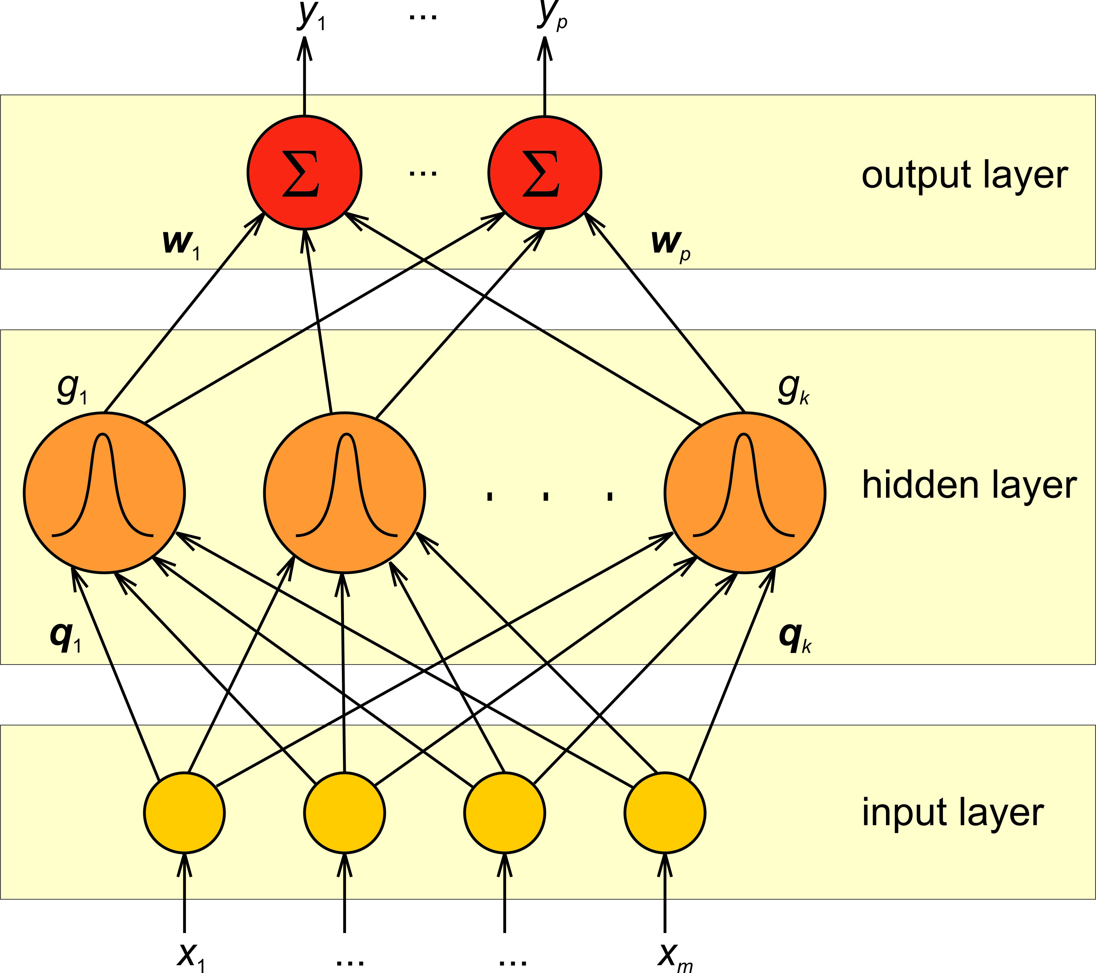
6.1 RBFN structure
Feedforward network with two computation layers
Hidden layer implements a set of radial basis functions (e.g. Gaussian functions)
Output layer implements linear summation functions (as in MLP)

Slide 4
RBFN properties
Two-stage training procedures
Training of hidden layer weights
Training of output layer weights
Training/learning is very fast
RBFN provides excellent interpolation

Slide 5
6.2 Exact interpolation (1/3)
Exact interpolation task = mapping of every input vector exactly onto the corresponding output vector in the multi-dimensional space
The goal is to find a function that will map input vectors x into target vectors t
Radial basis function approach (Powell, 1987) introduces a set of N basis functions, one for each data point x^{p}, in the form
Basis functions Φ are nonlinear and depend on the distance measure between input x and stored prototype x^{p}

Slide 6


Exact interpolation (2/3)
Output is a linear combination of basis functions
Goal is to find the weights w_{p} such that the function goes through all data points
We introduce the matrix formulation
Provided that the inverse of Φ exists, the weights are obtained by any standard matrix inversion techniques
→

Slide 7
Exact interpolation (3/3)
For a large class of functions Φ, the matrix is indeed non-singular provided that the data points are distinct
Solution represents a continuous differentiable surface that passes exactly through each data point
Both theoretical and empirical studies confirm (in the context of exact interpolation) that many properties of the interpolating function are relatively insensitive to the precise form of the basis functions
Various forms of basis functions can be used

Slide 8
6.3 Radial basis functions (1/2)
Gaussian
Multi-Quadratic
Generalized Multi-Quadratic
Inverse Multi-Quadratic

Slide 9

Radial basis functions (2/2)
Generalized Inverse Multi-Quadratic
Thin Plate Spline
Cubic
Linear

Slide 10
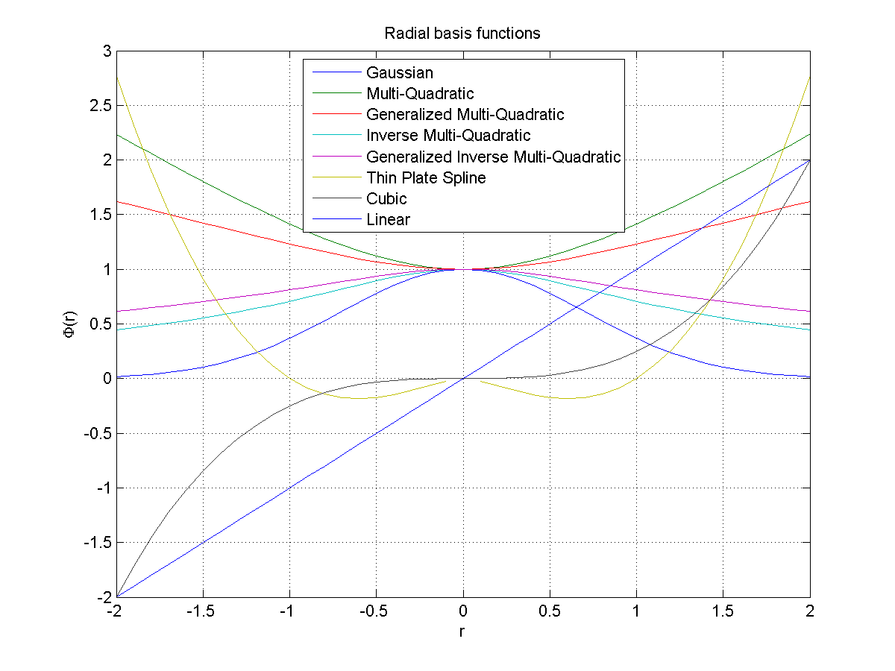

Slide 11
Properties of radial basis functions
Gaussian and Inverse Multi-Quadric basis functions are localized
Localised property is not strictly necessary → all the other functions (Multi-Quadratic, Cubic, Linear, ...) are not localized
Note that even the Linear Function is still non-linear in the components of x → In one dimension, this leads to a piecewise-linear interpolating function which performs the simplest form of exact interpolation
For neural network mappings, there are good reasons for preferring localized basis functions → we will focus on Gaussian basis functions

Slide 12
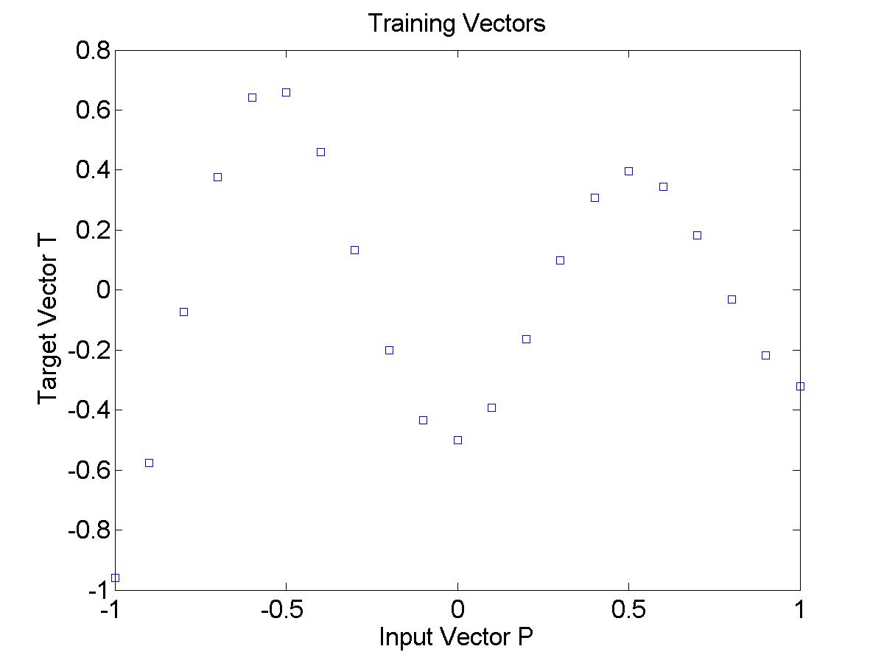
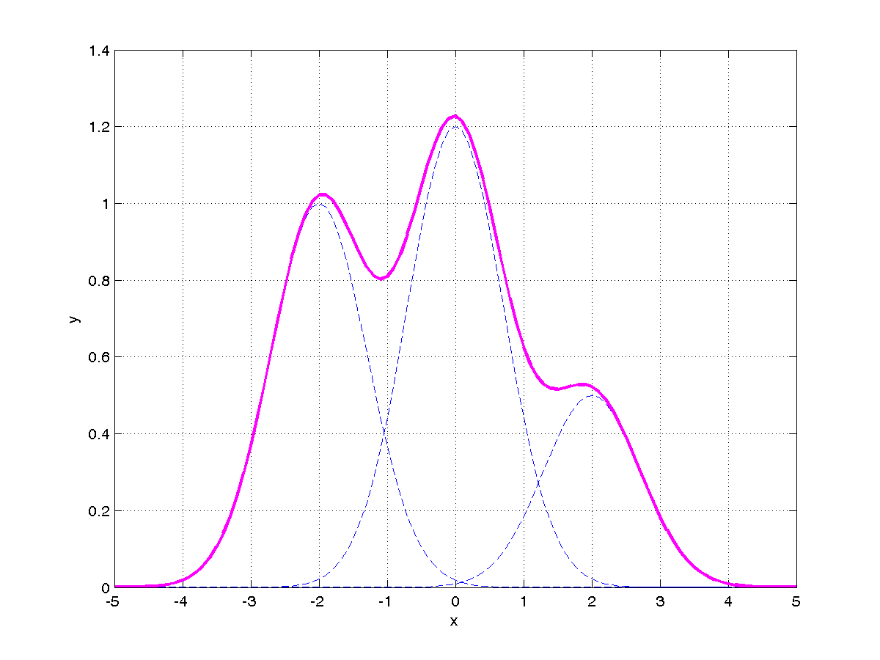
Exact interpolation example (1/2)
Interpolation problem
We would like to find a function which fits all data points
Solution approach
Superposition of Gaussian radial basis functions

Slide 13
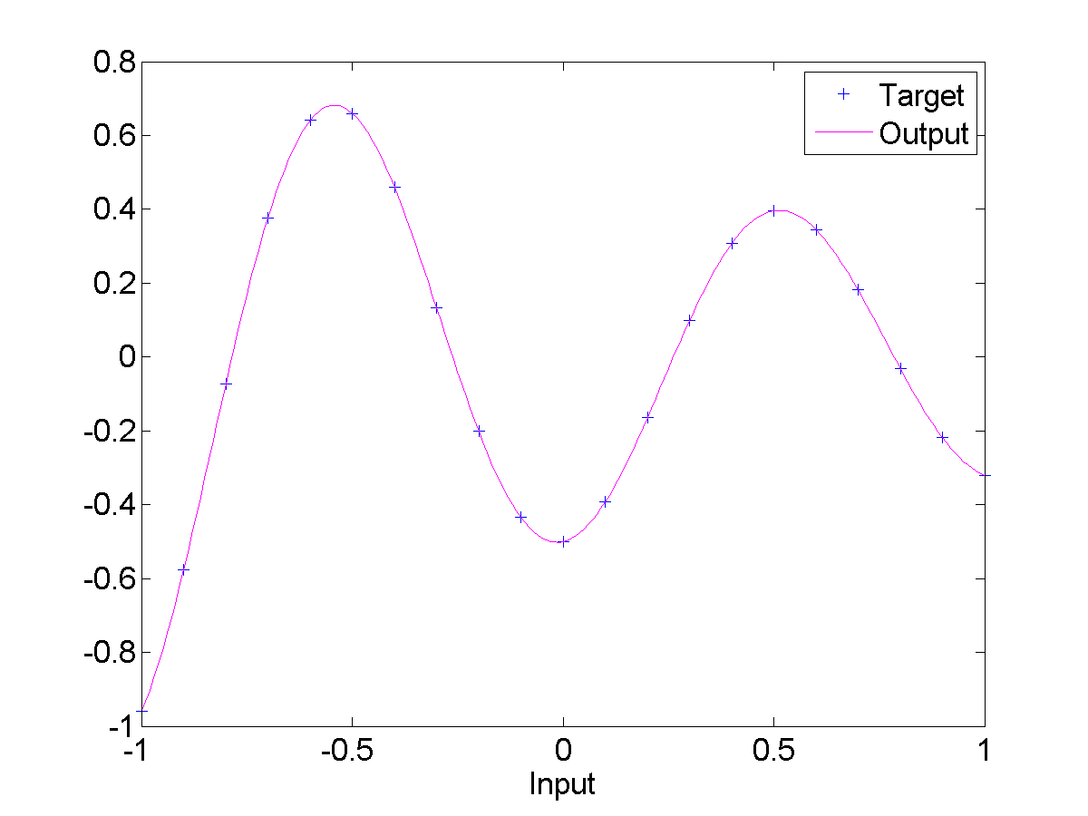
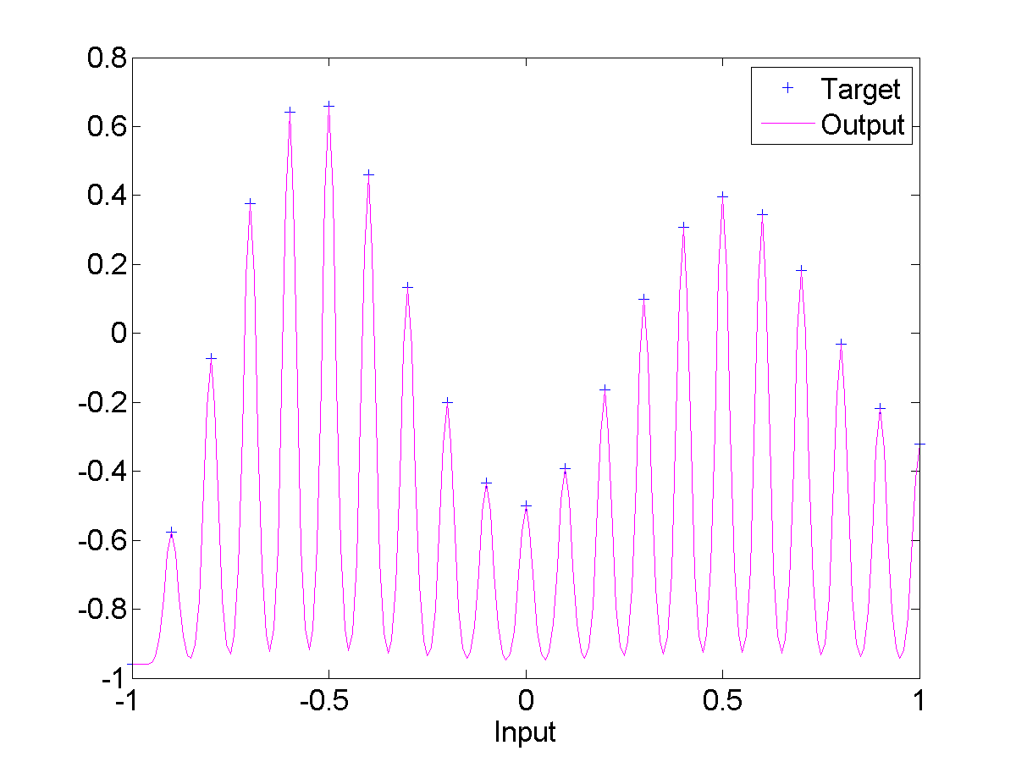
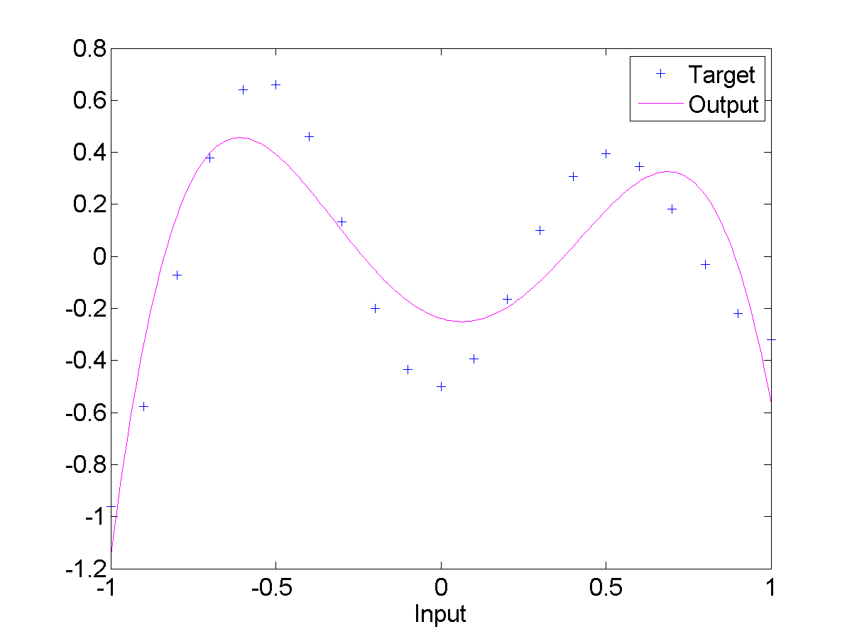
Exact interpolation example (2/2)
σ = 1
σ = 0.02
σ = 20

Slide 14
6.4 Radial basis function networks
Exact interpolation model using RB functions can already be described as a radial basis function network
N training inputs directly determine hidden layer prototypes (centers of hidden layer neurons)
Training inputs and outputs also directly determine output weights

Slide 15
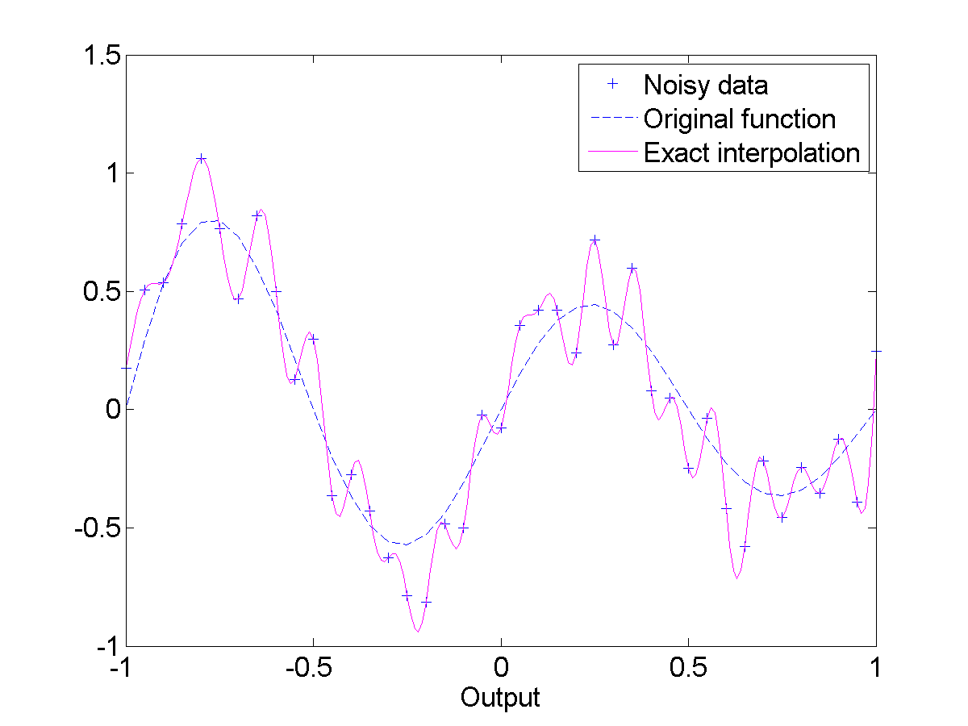
Problems with exact interpolation
Exact interpolation of noisy data is a highly oscillatory function → such interpolating functions are generally undesirable
Number of basis functions is equal to the number of data patterns → exact RBF networks are not computationally efficient

Slide 16
RBF neural network model
Introduced by Moody & Darken (1989) by several modifications of the exact interpolation procedure
Number M of basis functions (hidden units) need not equal the number N of training data points. In general, it is better to have M much less than N.
Centers of basis functions do not need to be defined as the training data input vectors. They can instead be determined by a training algorithm.
Basis functions need not all have the same width parameter σ. These can also be determined by a training algorithm.
We can introduce bias parameters into the linear sum of activations at the output layer. These will compensate for the difference between the average value over the data set of the basis function activations and the corresponding average value of the targets.
Notes:
https://doi.org/10.1162/neco.1989.1.2.281

Slide 17
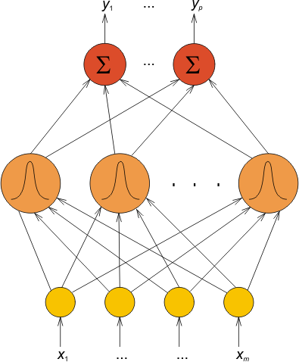
Improved RBFN
Including the proposed changes + expanding to the multidimensional output
Which can be simplified by introducing an extra basis function Φ₀ = 1
For the case of Gaussian RBF
centers
Φ₁ Φ_{M}
μ₁ μ_{M}
widths
||x-μ_{j}||² = (x₁-μ_{j1}) ² +...+(x_{M}-μ_{jM}) ²

Slide 18
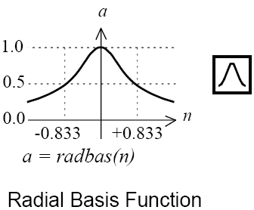
RBFN in MATLAB notation
RBF neuron
RBF network
center
width
centers
output weights
widths
biases

Slide 19
Computational power of RBFN
Hartman et al. (1990)
Formal proof of universal approximation property for networks with Gaussian basis functions in which the widths are treated as adjustable parameters
Girosi & Poggio (1990)
Showed that RBF networks have the best approximation property which states: „in the set of approximating functions there is one function which has minimum approximating error for any given function to be approximated.“ This property is not shared by multilayer perceptrons!
_________________________
As with the corresponding proofs for MLPs, RBFN proofs rely on the availability of an arbitrarily large number of hidden units (i.e. basis functions)
However, proofs provide a theoretical foundation on which practical applications can be based with a confidence

Slide 20
6.5 RBFN training
Key aspect of RBFN: Different roles of the first and the second computational layer
Training process can be divided into two stages
Hidden layer training
Output layer training
Hidden layer can be trained by unsupervised methods (random selection, clustering, ...)
Output layer has linear activation → output weights are determined analytically by solving a set of linear equations
Gradient descent learning is not needed for RBFN, therefore training is very fast!

Slide 21
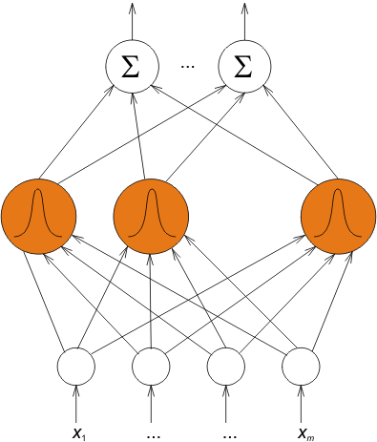
Hidden layer training
One major advantage of RBF networks is the possibility of choosing suitable hidden unit (basis function) parameters without having to perform a full nonlinear optimization of the whole network
Methods for unsupervised selection of basis function centers
Fixed centers selected randomly
Orthogonal least squares
K-means clustering
Problems with unsupervised methods
Selection of number of centers M
Selection of center widths σ
It is also possible to perform a full supervised non-linear optimization of the network instead

Slide 22
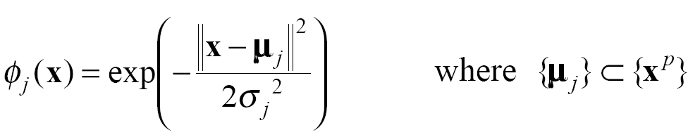
Fixed centers selected randomly
Simplest and quickest approach to setting RBFN parameters
Centers are fixed at M points selected randomly from the N data points
Widths are fixed to be equal at an appropriate size for the distribution of data points
Specifically, we can use RBFs centered at {μ_{j}} defined by
Widths σ_{j} are all related in the same way to the maximum or average distance between the chosen centers μ_{j}
Common choices are
which ensures that the individual RBFs are neither too wide, nor too narrow, for the given training data
For large training sets, this approach gives reasonable results

Slide 23
Orthogonal least squares
A more principled approach to select a sub-set of data points as the basis function centers is based on the technique of orthogonal least squares
Sequential addition of new basis functions, each centered on one of the data points
At each stage, we try out each potential Lth basis function by using the N–L other data points to determine the networks output weights
The potential Lth basis function which gives the smallest output error is used, and we move on to choose which L+1th basis function to add
To get good generalization we generally use cross-validation to stop the process when an appropriate number of data points have been selected as centers

Slide 24
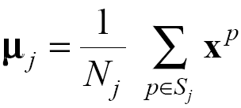
K-means clustering
A potentially even better approach is to use clustering techniques to find a set of centers that more accurately reflects the distribution of the data points
K-Means Clustering Algorithm
Select the number of centers (K) in advance
Apply a simple re-estimation procedure to partition the data points {x^{p}} into K disjoint sub-sets S_{j} containing N_{j} data points to minimize the sum squared clustering function
where μ_{j} is the mean/centroid of the data points in set S_{j} given by
Once the basis centers have been determined in this way, the widths can then be set according to the variances of the points in the corresponding cluster

Slide 25
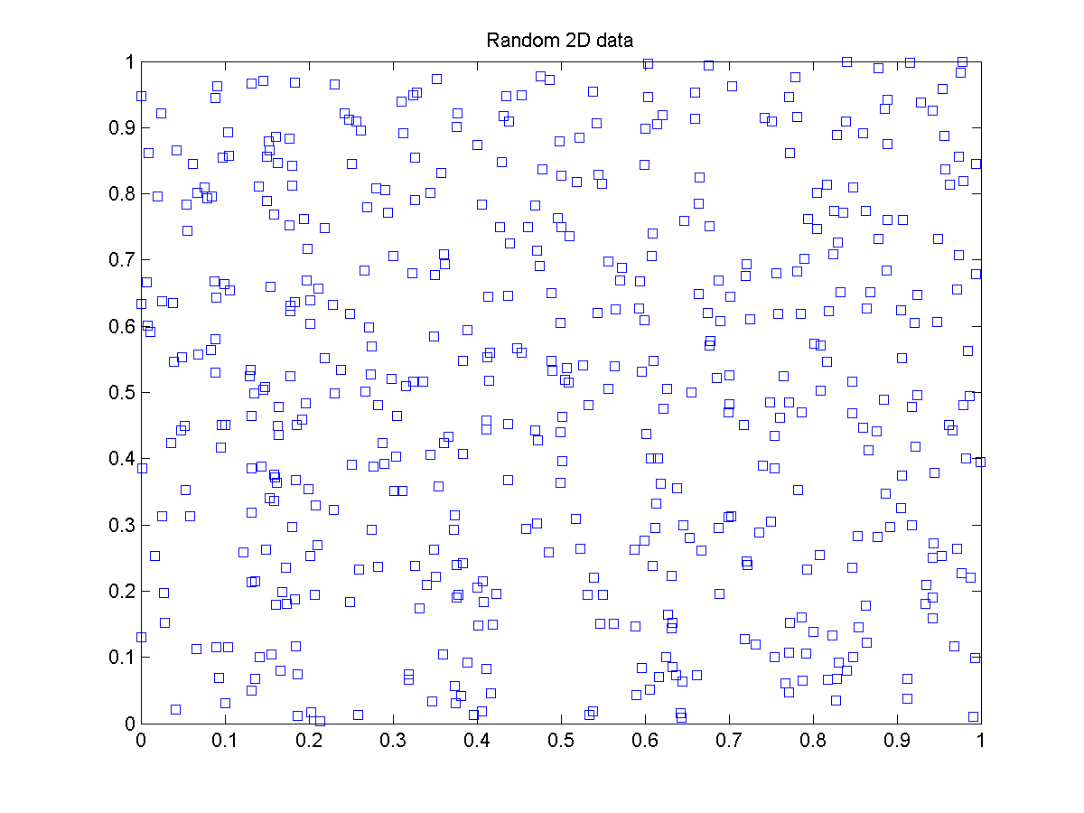
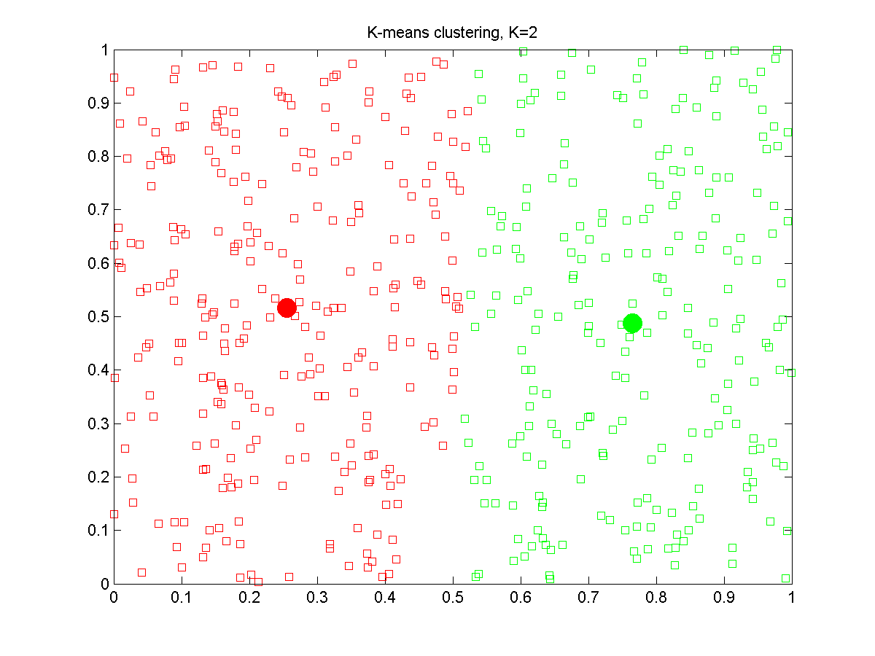
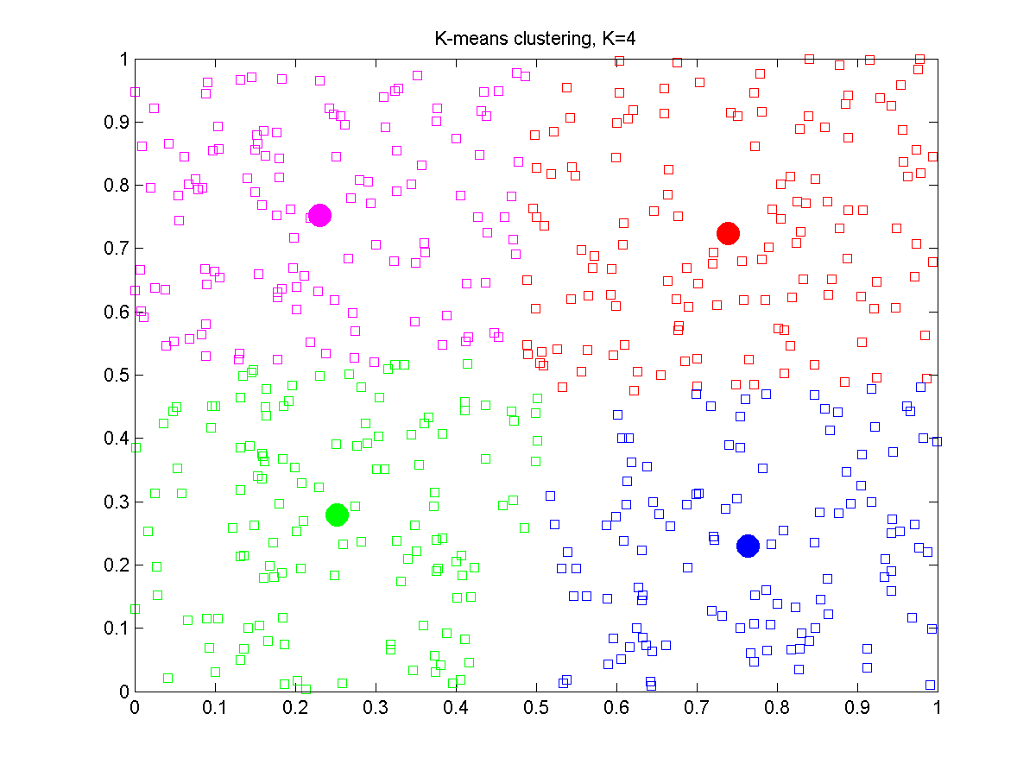
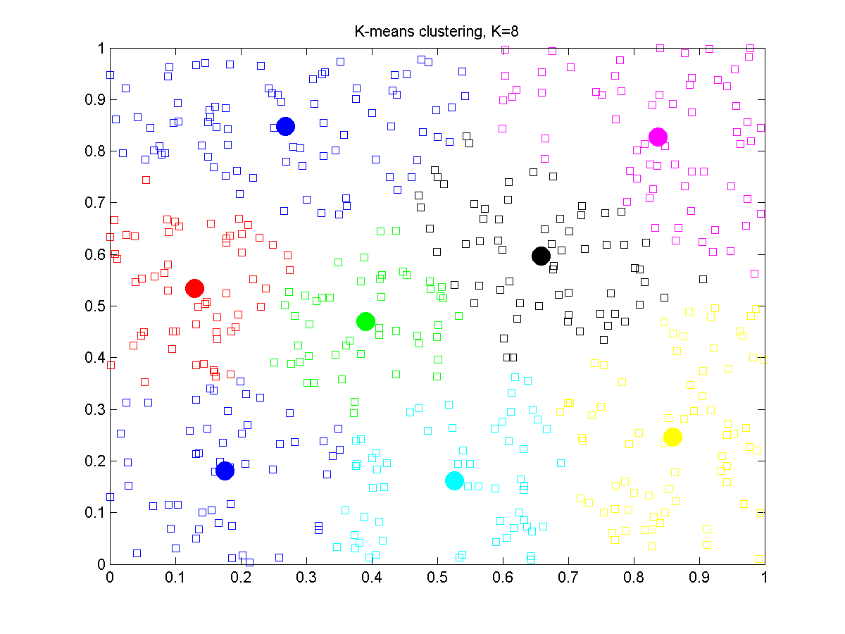
K-means clustering example

Slide 26
Output layer training
After training the hidden layer neurons (selection of centers and widths), output layer training essentially means optimization of a single layer linear network
As with MLPs, a sum-squared output error can be defined
At the minimum of E, gradients with respect to weights w_{ki} are zero

Slide 27
Computing the output weights
Equations for the weights are most conveniently written in matrix form by defining matrices
which gives
and the formal solution for the weights is
here we have the standard pseudo inverse of Φ
Network weights can be computed by fast linear matrix inversion techniques
In practice, singular value decomposition (SVD) is often used to avoid possible ill-conditioning of Φ, i.e. Φ^{T}Φ being singular or near singular
Notes:
matrix is singular (non invertible) if its determinant is zero

Slide 28
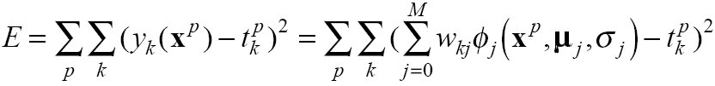
Supervised RBFN training
Supervised training of basis function parameters can give good results, but the computational costs are usually enormous
Obvious approach is to perform gradient descent on a sum squared output error function as in MLP backpropagation learning. Error function would be
Supervised RBFN training would iteratively update the weights (basis function parameters) using gradients

Slide 29
Supervised RBFN training
By using the Gaussian basis functions
derivatives of the error function
become very complex and therefore computationally inefficient
Additionally, we get all the problems of choosing the learning rates, avoiding local minima ... that we had for training MLPs by backpropagation
And there is a tendency for the basis function widths to grow large leaving non-localized basis functions

Slide 30
Regularization theory for RBFN
Alternative approach to prevent overfitting in RBFN
Based on the theory of regularization, which is a method of controlling the smoothness of mapping functions
We can have one basis function for each training data point as in the case of exact interpolation, but add an extra term to the error measure which penalizes mappings that are not smooth

Slide 31
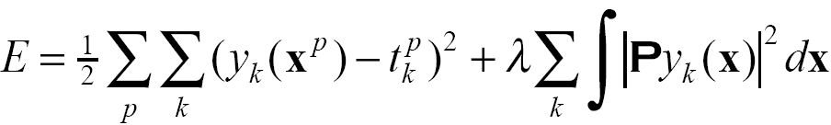
Regularization term in error measure
In the regularization approach, the error measure is modified with an additional regularization term that is composed of
differential operator P, and
regularization parameter λ
Regularization parameter λ determines the relative importance of smoothness compared with an error
Differential operator P can have many possible forms, but the general idea is that mapping functions that have large curvature should yield large regularization term and hence contribute a large penalty in the total error function

Slide 32
RBFN training summary
Option 1) Exact interpolation model + Regularization
Option 2) Supervised RBFN training
Option 3) Two-stage hybrid training
3a) Hidden layer training
Fixed centers selected randomly
Orthogonal least squares
K-means clustering
3b) Output layer training
Linear matrix operation
Where to start?
→ Two-stage hybrid training with K-means clustering and linear matrix operation for the output layer

Slide 33
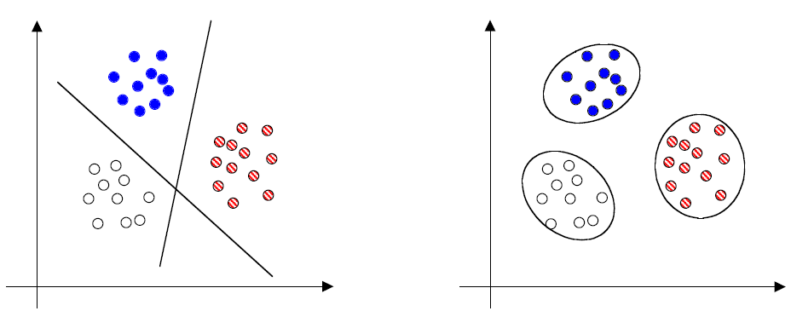
6.6 RBFN for classification
Key insight into RBFN can be obtained by using such networks for classification problems
Suppose we have data set with three classes
MLP RBFN
Multilayer perceptron can separate classes by using hidden units to form hyperplanes in the input space
Alternative approach is to model the separate class distributions by localized radial basis functions

Slide 34
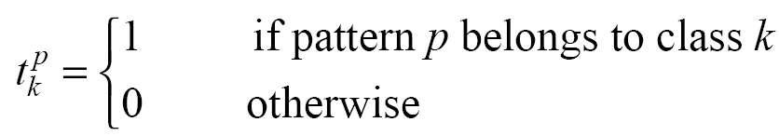
Implementing RBFN for classification
Define an output function y_{k}(x) for each class k with appropriate targets
RBFN is trained with input patterns x and corresponding target classes t
Underlying justification for using RBFN for classification is found in Cover’s theorem which states
A complex pattern classification problem cast in a high dimensional space non-linearly is more likely to be linearly separable than in a low dimensional space.
Once we have linear separable patterns, the classification problem can be solved by a linear layer
Notes:
SVM with polynomial kernel visualization.flv

Slide 35
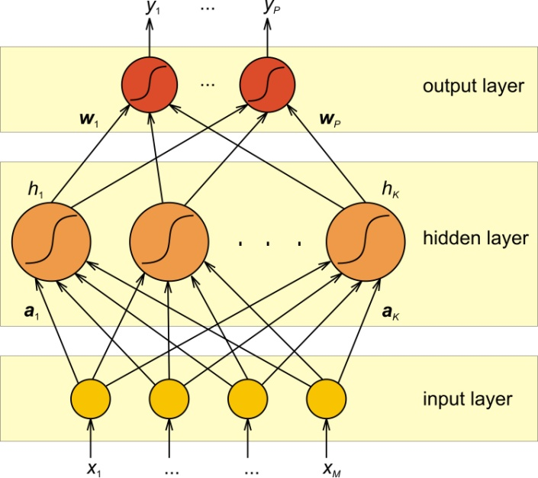
6.7 Comparison with multilayer perceptron
Similarities between RBF networks and MLPs
They are both non-linear feed-forward networks
They are both universal approximators for arbitrary nonlinear functional mappings
They can be used in similar application areas
There always exists an RBF network capable of accurately mimicking a specified MLP or vice versa
MLP RBFN

Slide 36
RBFN / MLP differences
RBFN
Single hidden layer
Hidden nodes (basis functions) operate very differently, and have a different purpose compared to the output nodes
Argument of each hidden unit activation function is the distance between the input and the “weights” (RBF centers)
Usually trained one layer at a time with the first layer unsupervised
Use localized nonlinearities (Gaussians) at the hidden layer to construct local approximations
Fast training
MLP
Can have any number of hidden layers
Computation nodes (processing units) in different layers share a common neuronal model, though not necessarily the same activation function
Argument of each hidden unit activation function is the inner product of the input and the weights
Usually trained with a single global supervised algorithm
Construct global approximations to non-linear input-output mappings with distributed hidden representations
Require a smaller number of parameters

Slide 37
6.8 Probabilistic networks
Probabilistic neural networks (PNN) can be used for classification problems
First layer computes distances from the input vector to the training input vectors (prototypes) and produces a vector whose elements indicate how close the input is to a training input
Second layer sums these contributions for each class of inputs to produce as its net output a vector of probabilities
Finally, a competitive output layer picks the maximum of these probabilities, and produces “1” for that class and “0” for the other classes

Slide 38
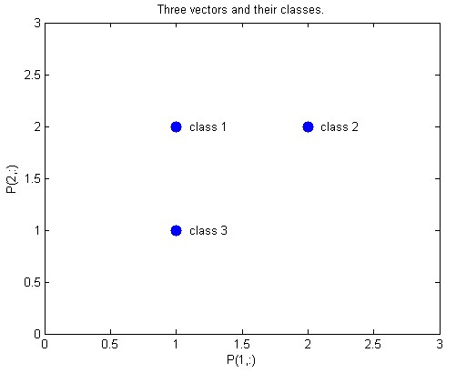
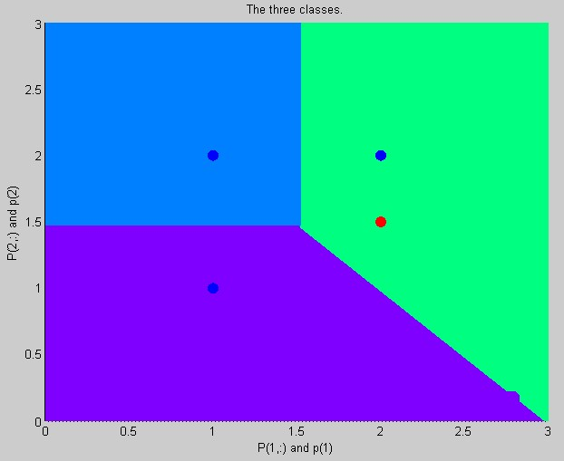
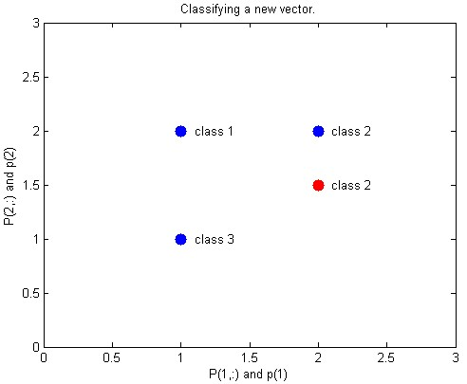
MATLAB demo
Run built-in command in MATLAB:
>> demopnn1 % PNN example
Three training patterns
PNN division of the input space
Classifying new sample

Slide 39
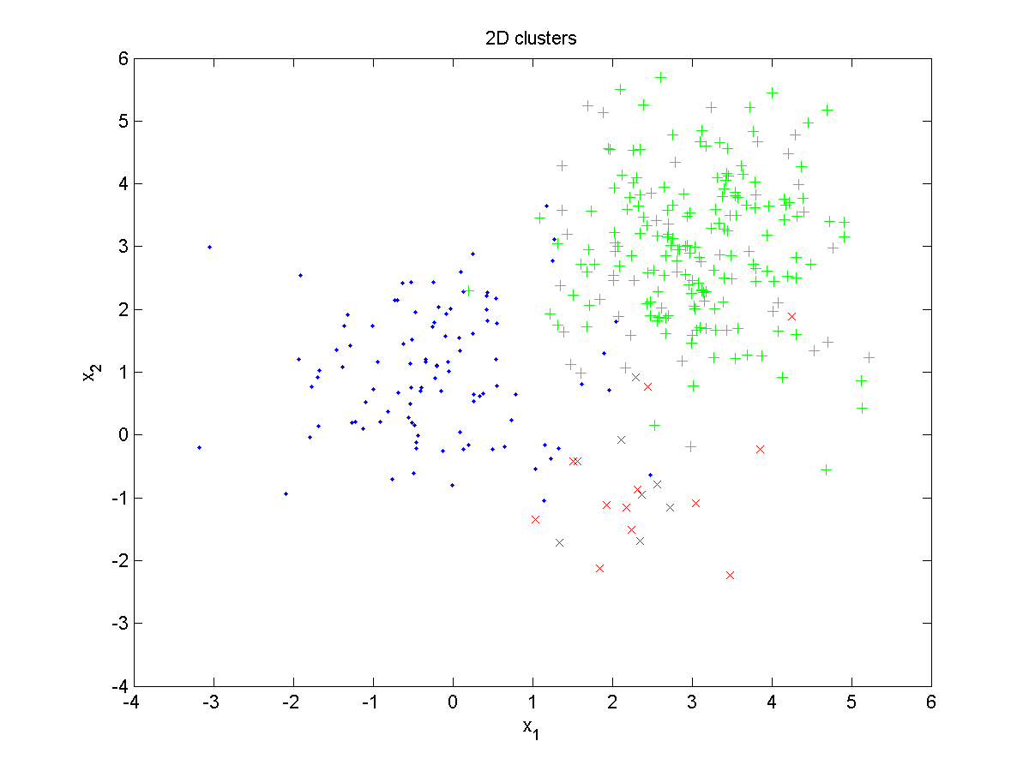
PNN example 2 (1/4)
Generate training data
Notes:
MATLAB demopnn1

Slide 40
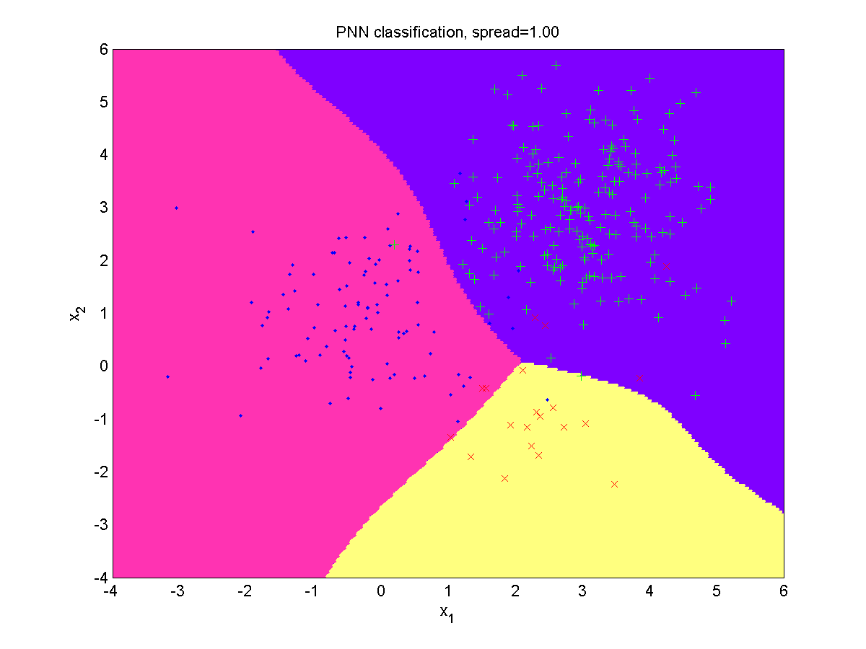
PNN example 2 (2/4)
PNN result, spread = 1.00, → optimal
Notes:
MATLAB demopnn1

Slide 41
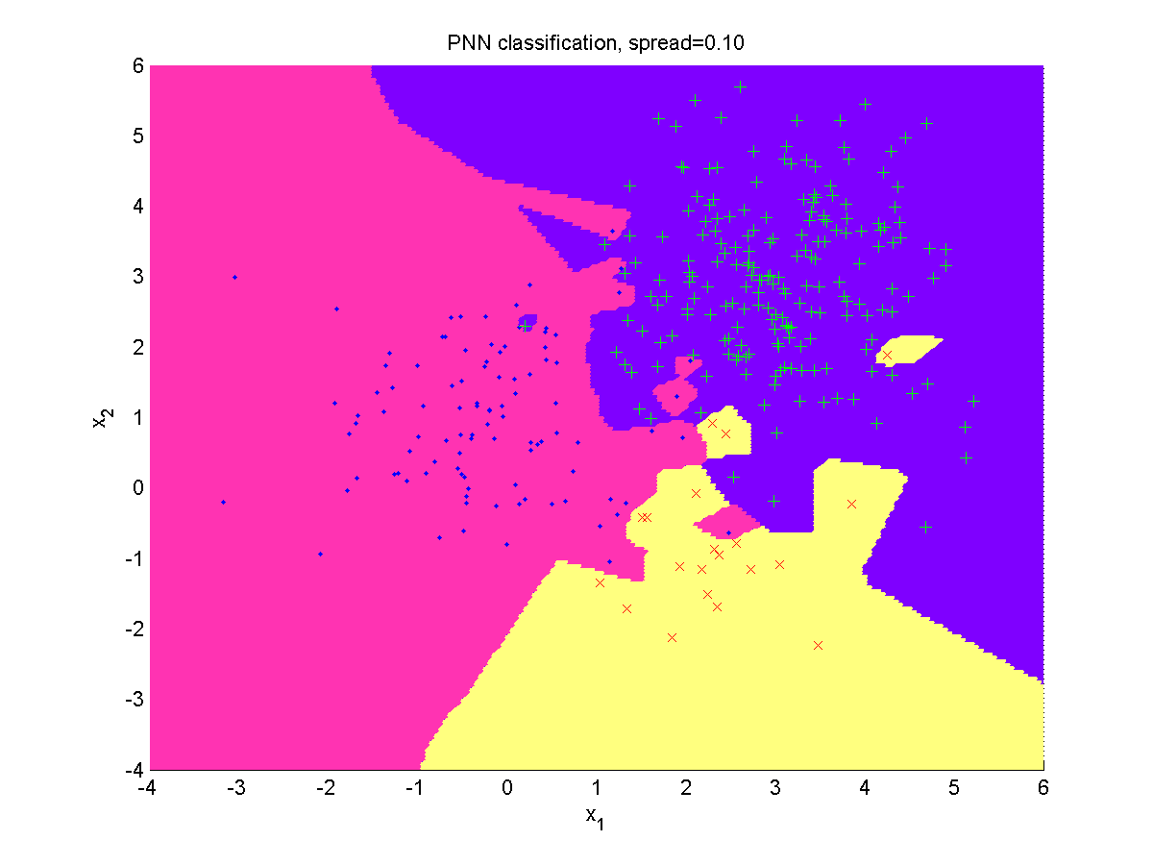
PNN example 2 (3/4)
PNN result, spread = 0.10 → overfitting
Notes:
MATLAB demopnn1

Slide 42
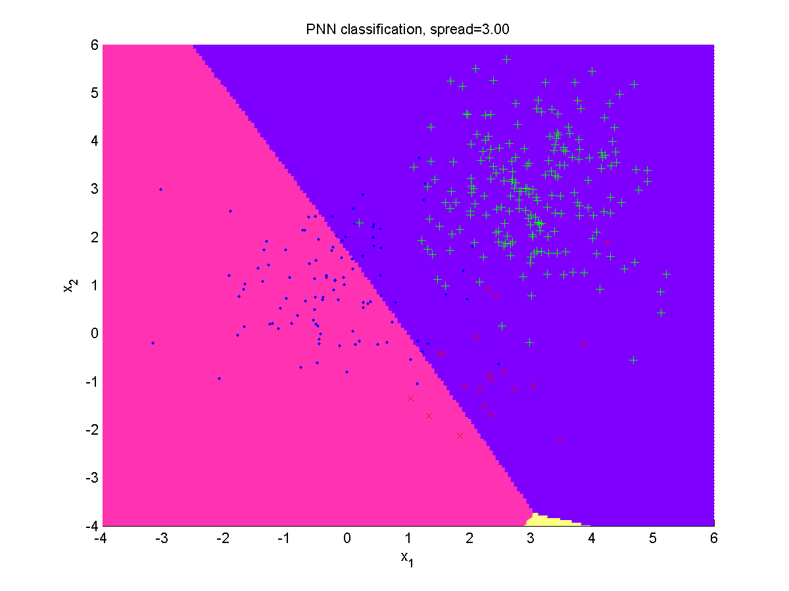
PNN example 2 (4/4)
PNN result, spread = 3.00 → underfitting
Notes:
MATLAB demopnn1

Slide 43
PNN considerations
Probabilistic neural networks are specialized in classification (less general than RBFN or MLP)
PNN are sensitive to the selection of spread parameter → spread can be optimized by leave-one-out cross-validation technique
Leave one training sample out, train PNN, and test on the omitted sample
Repeat the procedure for all samples and save the results
Find an optimal spread that yields minimal average classification error
Benefits
Little or no training required (except spread optimization)
Besides classifications, PNN also provides Bayesian posterior probabilities → solid theoretical foundation to support confidence estimates for the network’s decisions
Robust against outliers → outliers have no real effect on decisions
Drawbacks
PNN performance depends strongly on a thoroughly representative training set
Entire training set must be stored → large memory and poor execution speed

Slide 44
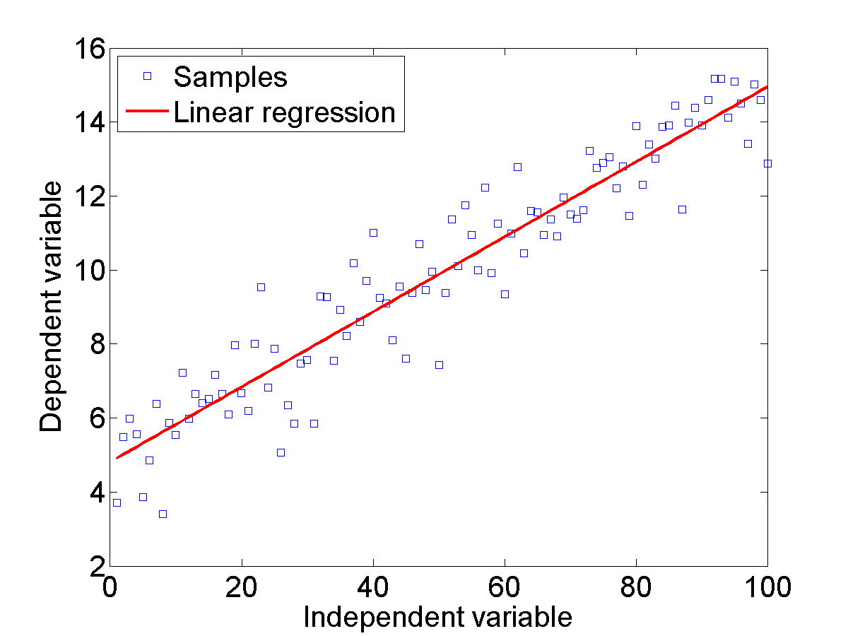
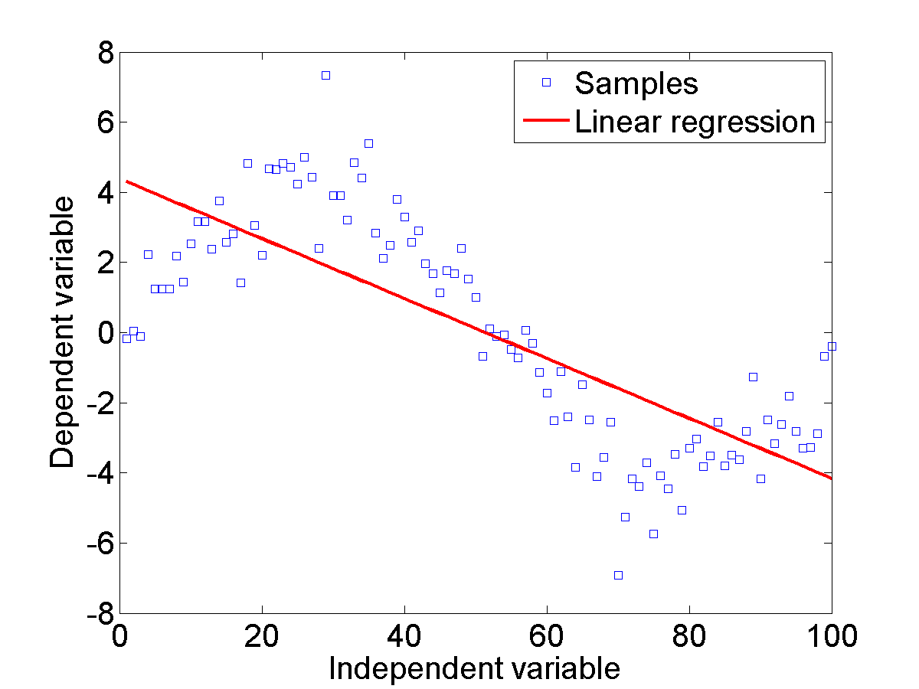
6.9 Generalized regression networks
GRNN can be well explained by reviewing the regression problem: How to use measured values (independent variables) to predict the value of a dependent variable?
Linear regression is OK Linear regression fails

Slide 45
Simple linear regression
Simple linear regression is expressed with
Given the training data, the slope a and bias b are computed as
Compute the sum of squares
Compute slope and bias
Resulting linear equation will minimize mean squared error of predicted values y in the training set

Slide 46
Multiple regression
Several independent variables x₁, x₂, x₃, ...
Matrix notation
Pack training data into matrices
Parameter can be expressed as
Final solution is usually obtained numerically by singular value decomposition method (SVD)

Slide 47
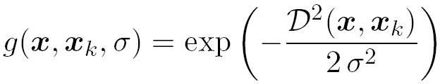
General regression neural network
Best predictor for dependent variable y is defined by its conditional expectation, given the independent variable x
Joint density function f_{xy}(x,y) is not known but can be approximated by the Parzen estimator
By using the Parzen approximator with Gaussian kernels, we obtain an equation for the GRNN predictor

Slide 48
GRNN properties
GRNN closely resembles RBFN with normalization term in the denominator → it is sometimes called “Normalized RBFN”
GRNN also resembles PNN but is used for regression (function approximation), not for classification
Width parameter spread must be selected, as in all RBF networks
The first layer has Gaussian kernels located at each training case and computes distances from the input vector to the training input vectors (prototypes)
Second layer is a special linear layer with a normalization operator
Normalization makes GRNN a very robust predictor

Slide 49
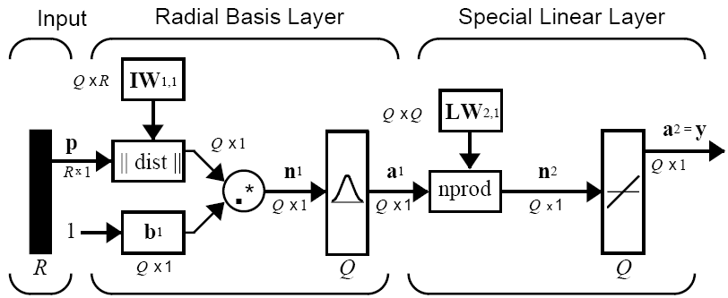
GRNN architecture
Standard Radial basis layer Normalization Linear layer

Slide 50
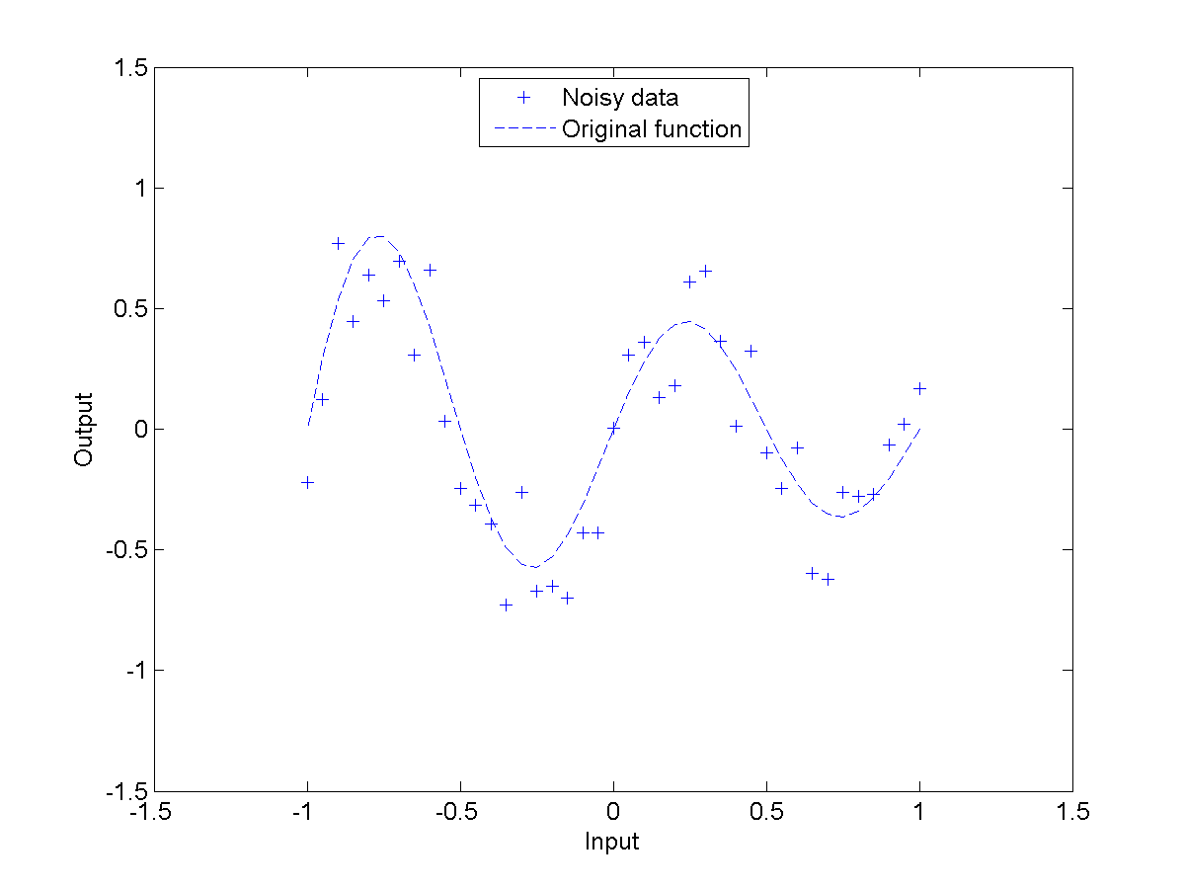
RBFN vs. GRNN example (1/3)

Slide 51
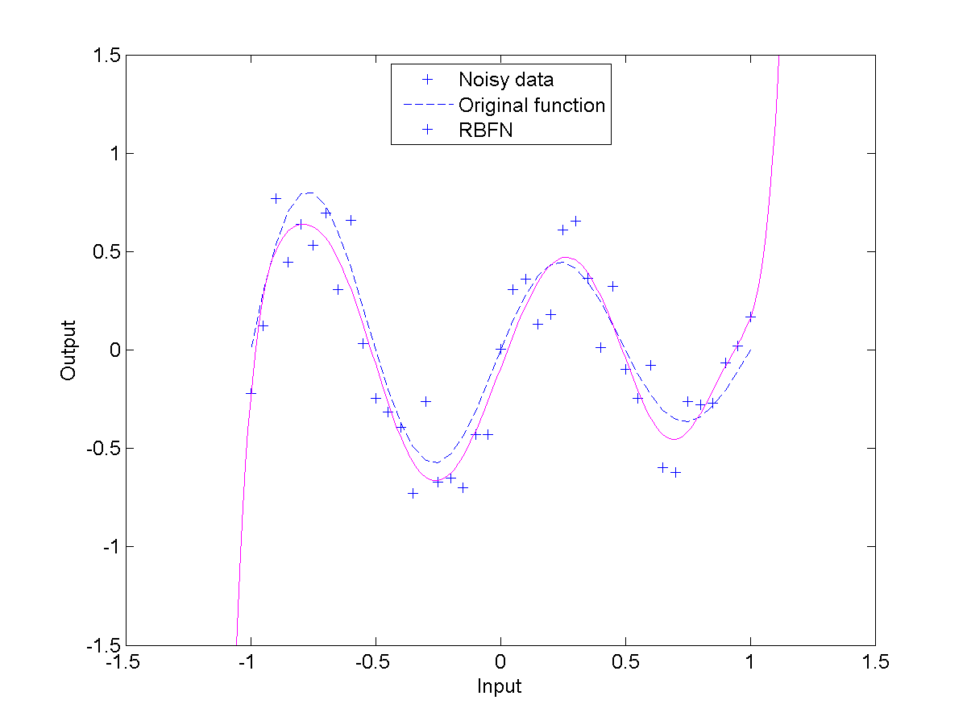
RBFN vs. GRNN example (2/3)

Slide 52
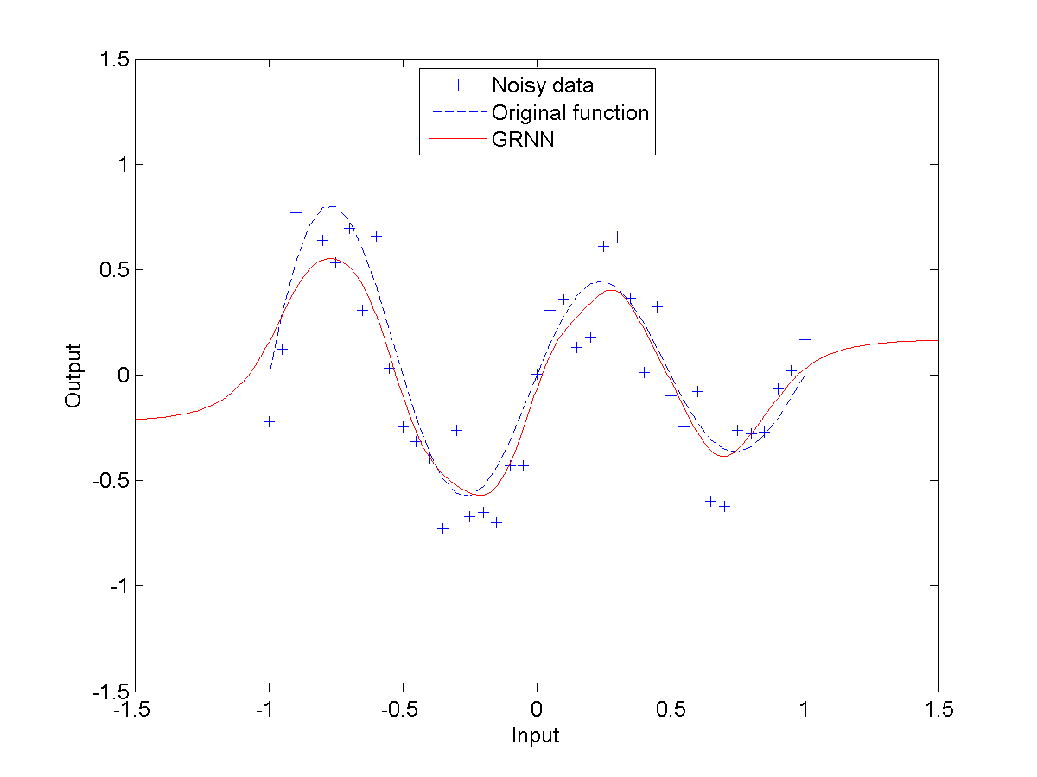
RBFN vs. GRNN example (3/3)

Slide 53
Summary
RBFN
PNN
GRNN
Notes:
Summary: RBFN can be used for regression or classification, PNN is designed for classification, and GRNN is designed for regression.

Slide 54
6.10 MATLAB Live Script examples
NN6b_RBFN_function_approx.mlx
Apply various RBFN architectures to create function approximation models based on a measured data set. Compare results with Linear regression and Multilayer perceptron models.
NN6c_RBFN_classification_XOR.mlx
Two groups of linearly inseparable data are defined in 2-dimensional input space. Solve the XOR classification problem with a family of RBFN neural networks.

